Slide 1
Special Course in Software Engineering 24
MINI-PROJECT PRESENTATION
GROUP NO. 24: Confusion Matrix

Slide 2
Group Introduction

Slide 3
Project module and module leader
Module Name | Module leaders
Data Inspection and Plotting | Qihao Zhuang, Yifan Li
Analysis and Hypothesis Testing | Bo Zhang, Yifan Li
Sentiment Analysis (NLP) | Yikai Zhang, Yifan Li
Data Cleaning and preprocessing | Yifan Li
Main Module | Yifan Li

Slide 4
Dataset

Slide 5
Dataset introduction
Dataset name:
Heart attack prediction dataset
Brief description:
The Heart Attack Risk Prediction Dataset is a valuable tool for understanding the predictors of heart health and the risk factors associated with heart attacks.
It includes diverse attributes such as age, cholesterol levels, lifestyle choices, and medical history, enabling researchers and healthcare professionals to apply predictive analytics and machine learning for proactive heart disease prevention.
With 8,763 records from patients worldwide, this dataset supports comprehensive analysis and research aimed at improving cardiovascular health outcomes.

Slide 6
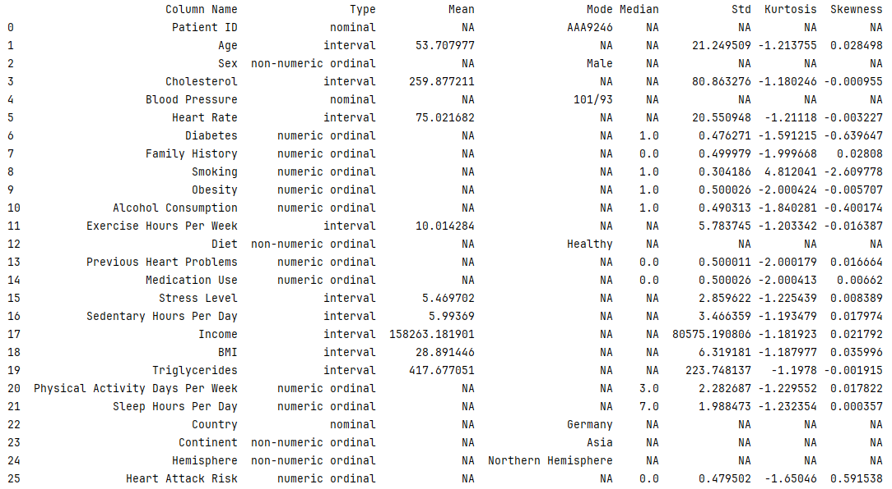

Slide 7
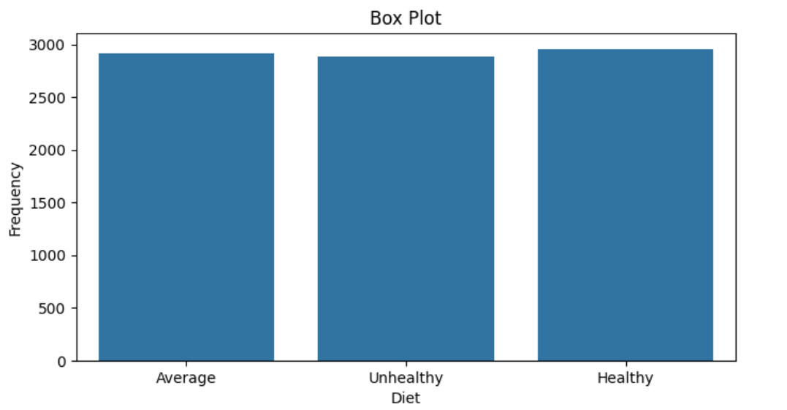
(Variable Name # Diet) distribution
This box plot compares three categories: Average, Unhealthy Diet, and Healthy.
The plot shows little to no variation within each category, as the boxes appear as single lines without visible whiskers or outliers.
All three categories have similar frequency values, around 2900-3000, with the Healthy category showing a slightly higher frequency than the others.

Slide 8
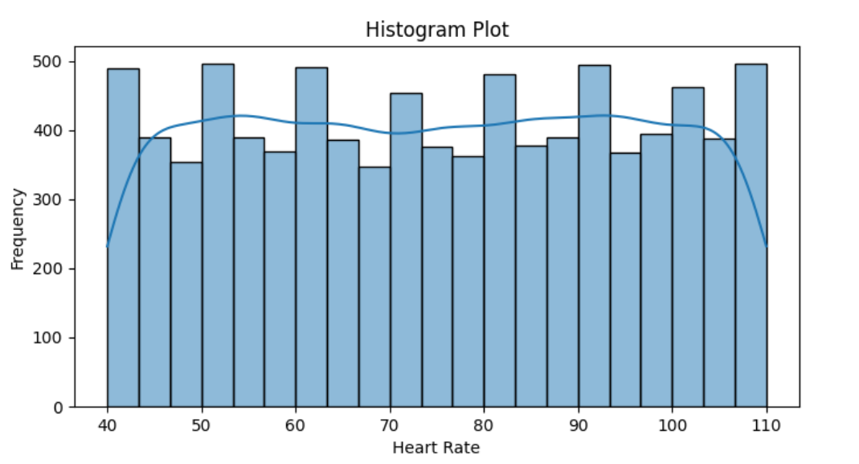
(Variable Name # Heart Rate) distribution
This histogram shows the distribution of heart rates.
The data exhibits a roughly normal distribution shape, with most heart rates concentrated in the middle range (about 70-90 beats per minute).
The distribution is slightly right-skewed, indicating that higher heart rates occur somewhat more frequently than lower ones.

Slide 9
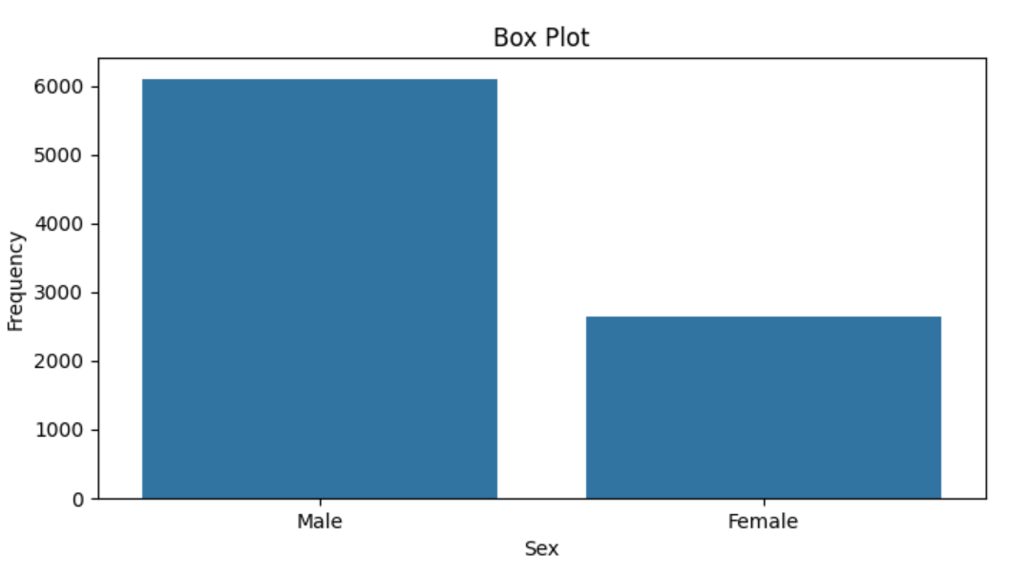
(Variable Name # Gender) distribution
This box plot compares the frequency distribution between Male and Female categories.
The Male category shows a significantly higher frequency, around 6000, compared to the Female category, which has a frequency of about 2700. The plot displays no variability within each category, appearing as single bars rather than traditional box plots with quartiles and whiskers.
This suggests the data represents aggregate counts or averages for each gender rather than individual data points.

Slide 10
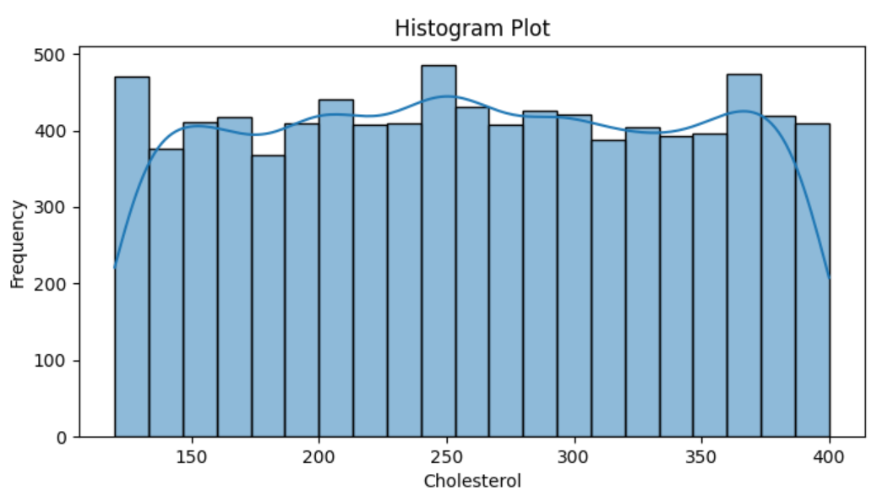
(Variable Name # Cholesterol) distribution
This histogram displays the distribution of cholesterol levels.
The data shows a relatively uniform distribution across most cholesterol values, with frequencies generally ranging between 350-450. There are slight peaks around 250 and 375 cholesterol levels. The blue line overlaid on the bars represents a smoothed trend of the distribution, highlighting these subtle variations.
Overall, the distribution doesn't show a strong central tendency, suggesting a wide range of cholesterol levels in the population sampled.

Slide 11
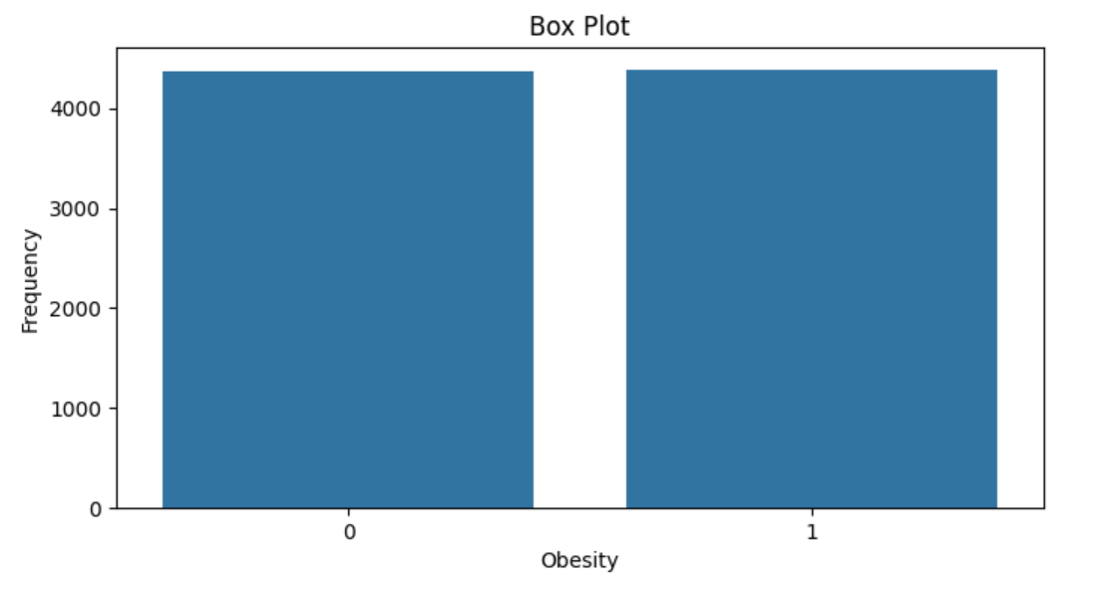
(Variable Name # Obesity) distribution
This box plot compares two categories related to obesity, likely representing non-obese (0) and obese (1) individuals.
Both categories show nearly identical frequencies, around 4400-4500. The plot displays no variability within each category, appearing as single bars rather than traditional box plots with quartiles and whiskers.
This suggests the data represents aggregate counts or averages for each obesity status, with a remarkably even distribution between the two groups in the sampled population.

Slide 12
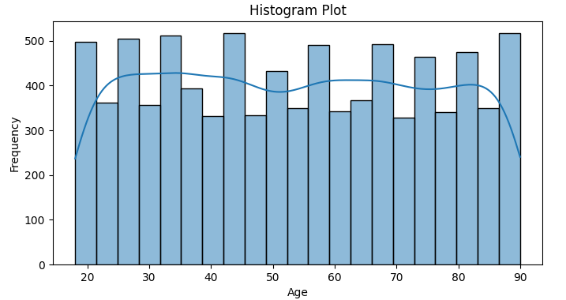
(Variable Name # Age) distribution
This is a histogram plot showing the age distribution.
It displays the frequency of different age groups, with age on the x-axis (ranging from 20 to 90) and frequency on the y-axis.
The overall distribution roughly follows a bell curve shape, though there are some fluctuations across the age ranges.

Slide 13
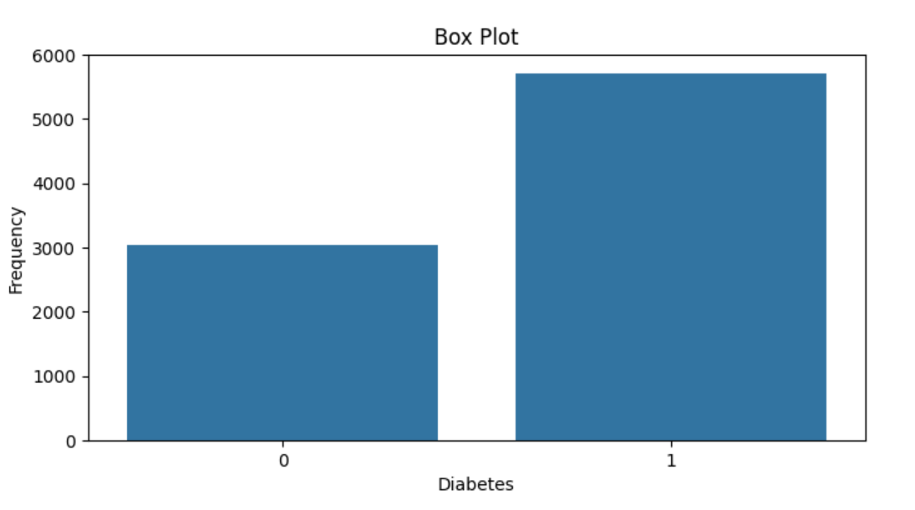
(Variable Name # Diabetes) distribution
This box plot compares the frequency of two categories related to diabetes, likely representing non-diabetic (0) and diabetic (1) individuals.
The diabetic category (1) shows a much higher frequency, around 5700, compared to the non-diabetic category (0), which has a frequency of about 3000.
The plot displays no variability within each category, appearing as single bars rather than traditional box plots, suggesting these are aggregate counts for each group.

Slide 14
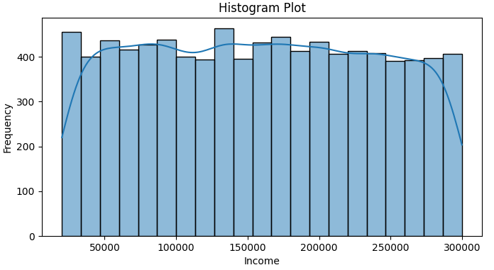
(Variable Name # Income) distribution
This histogram plot displays the distribution of income across different ranges.
The x-axis represents income levels from approximately 0 to 300,000 (likely in currency units), while the y-axis shows the frequency or count of individuals in each income bracket.
The distribution appears relatively uniform across most income levels, with slight variations in frequency. The highest frequencies seem to occur in middle income ranges, with slightly lower frequencies at the extreme ends of the income spectrum.

Slide 15
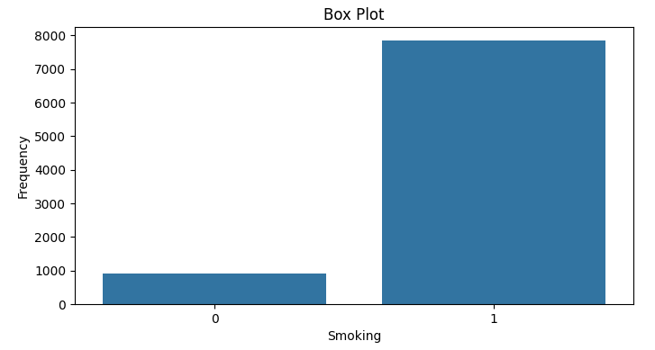
(Variable Name # Smoking) distribution
This box plot compares the frequency of two smoking categories, likely representing non-smokers (0) and smokers (1).
The plot shows a stark contrast between the two groups, with category 1 having a much higher frequency, reaching nearly 8000, while category 0 only reaches about 1000.
This suggests a significantly larger number of individuals classified as smokers in the dataset.

Slide 16
Analysis

Slide 17
Hypothesis #1：Analyze numeric and category data.
Analyze：
Data: Diet (Healthy, Average, Unhealthy) vs. Heart Rate
Numeric data：Heart Rate
Category data： Diet (Healthy, Average, Unhealthy)
Hypothesis：
H₀ (Null Hypothesis) : There is no significant effect of diet on heart rate.
H_{a} (Alternative Hypothesis) : There is a significant effect of diet on heart rate.

Slide 18
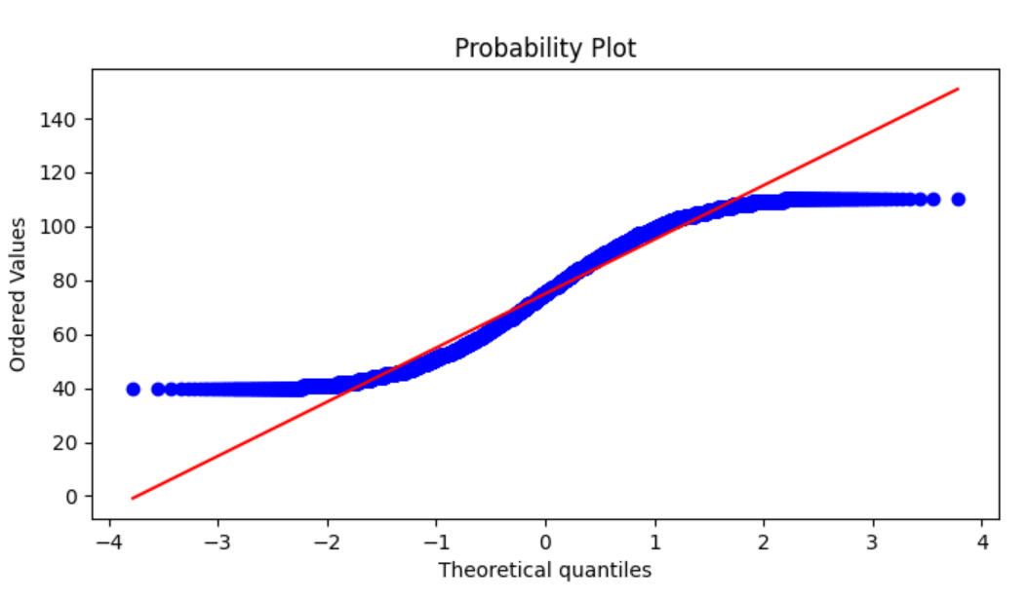
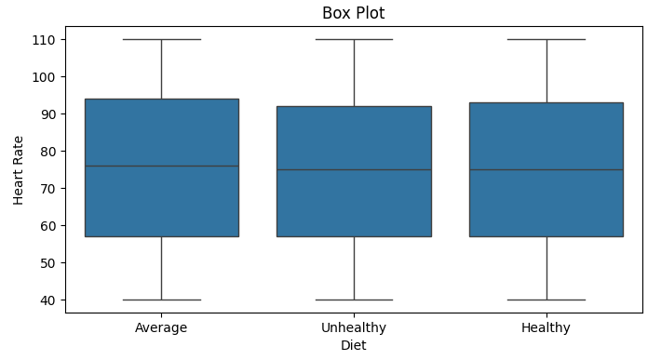
Testing Hypothesis #1
This probability plot suggests the distribution is not perfectly normal.
This box plot compares heart rates across three diet categories: Average, Unhealthy, and Healthy.
The distributions appear largely similar, with median heart rates around 75 beats per minute for all groups.
There's a slight trend suggesting the Healthy diet group may have a marginally lower median heart rate, but the differences are subtle.

Slide 19
Testing Hypothesis #1
"Anderson-Darling": {
"test": "Anderson-Darling",
"statistic": 102.29183776167338,
"p_value": 0.0,
"is_normal": false
}
"Kruskal-Wallis": {
"test": "Kruskal-Wallis",
"statistic": 8762.000000000002,
"p_value": 0.49799089453512324,
"is_significant": false
}
1. Anderson-Darling Test
The Anderson-Darling test is a non-parametric test used to determine whether a dataset follows a normal distribution. The statistic value of 102.29 indicates a very high degree of deviation from normality.
The p-value of 0.0 provides very strong evidence to reject the null hypothesis, which states that "the data follows a normal distribution." Therefore, the result indicates that the data does not conform to a normal distribution.
2. Kruskal-Wallis Test
The Kruskal-Wallis test is a non-parametric method used to compare three or more independent samples, similar to one-way ANOVA. Here, the statistic value is 8762.00.
The p-value of 0.498, which is above the common significance level (e.g., 0.05), indicates that there is not enough evidence to reject the null hypothesis, which states that there are no significant differences between the different samples. Therefore, the result suggests that there are no significant differences in medians among the samples.

Slide 20
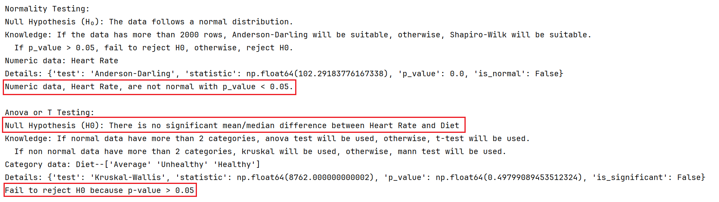
Testing Hypothesis #1
The Anderson-Darling test indicates that the data does not follow a normal distribution, while the Kruskal-Wallis test shows that there are no significant differences among the samples.

Slide 21
Hypothesis #2：Analyze numeric and category data.
Analyze：
Data: Sex vs. Cholesterol
Numeric data：Cholesterol
Category data： Sex
Hypothesis：
H₀ (Null Hypothesis) : There is no significant effect of gender on Cholesterol.
H_{a} (Alternative Hypothesis) : There is a significant effect of gender on Cholesterol.

Slide 22
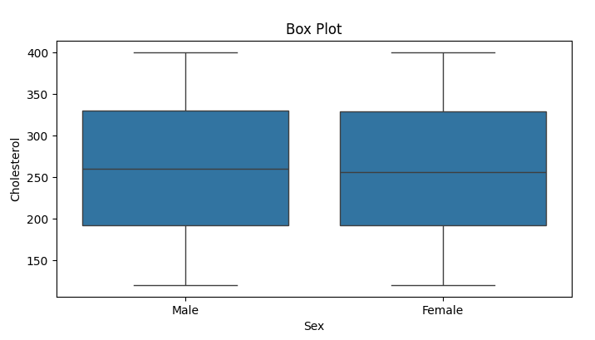
Testing Hypothesis #2
This probability plot suggests the distribution is not perfectly normal.
This box plot compares cholesterol levels between males and females. The distributions are very similar for both sexes, with median values around 260 mg/dL. Both groups show a wide range of cholesterol levels, from about 120 to 400 mg/dL. The interquartile ranges (box sizes) are nearly identical, suggesting similar variability in cholesterol levels for males and females. Overall, the data indicates no substantial difference in cholesterol levels between the sexes based on this sample.

Slide 23
Testing Hypothesis #2
"Anderson-Darling": {
"test": "Anderson-Darling",
"statistic": 91.34459292230349,
"p_value": 0.0,
"is_normal": false
}
"Mann-Whitney U": {
"test": "Mann-Whitney U",
"statistic": 0.0,
"p_value": 1.0,
"is_significant": false
}
1. Anderson-Darling Test
The Anderson-Darling test is a non-parametric test used to determine whether a dataset follows a normal distribution. The statistic value of 91.34 indicates a significant deviation from normality.
The p-value of 0.0 provides strong evidence to reject the null hypothesis, which states that "the data follows a normal distribution." Thus, the result shows that the data does not conform to a normal distribution.
2. Mann-Whitney U Test
The Mann-Whitney U test is a non-parametric test used to assess whether there are differences between two independent samples. The statistic value of 0.0 suggests that one group has a lower rank than the other.
However, the p-value of 1.0 indicates that there is no significant difference between the two groups. Therefore, the result suggests that the difference between the groups is not statistically significant.

Slide 24
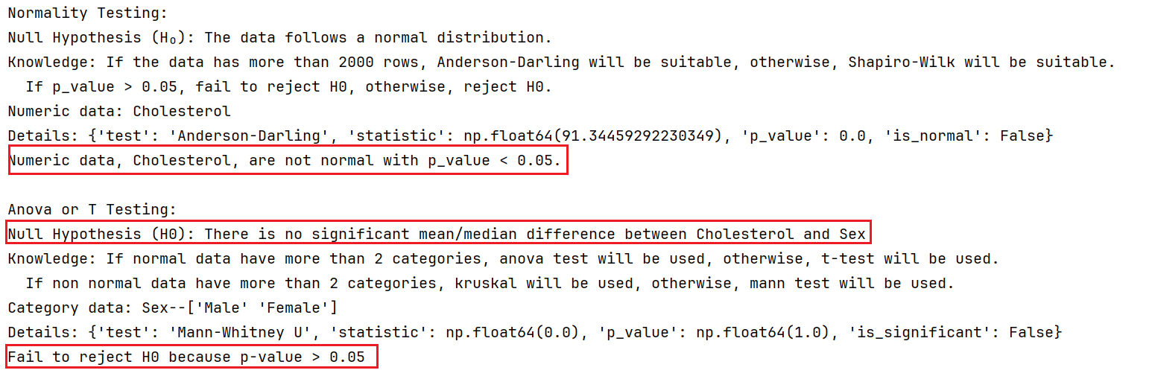
Testing Hypothesis #2
The results indicate that the data does not follow a normal distribution, as shown by the significant Anderson-Darling test statistic and p-value.
Mann-Whitney U test results suggest that there is no significant difference between the two independent samples.

Slide 25
Hypothesis #3：Analyze category data.
Analyze：
Data: Diabetes VS Obesity
Category data： Diabetes
Category data： Obesity
Hypothesis：
H₀ (Null Hypothesis) : There is no significant difference between Diabetes on Diabetes.
H_{a} (Alternative Hypothesis) : There is a significant difference between Diabetes on Diabetes.

Slide 26
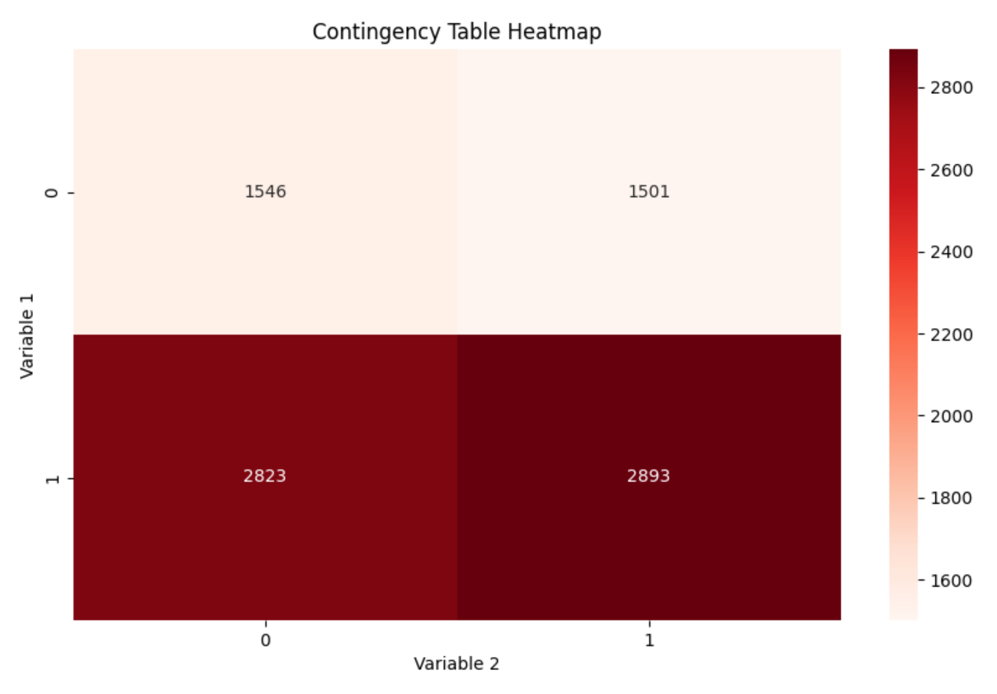
Testing Hypothesis #3
This contingency table heatmap shows the relationship between two variables, each with two categories (0 and 1). The data is presented in a 2x2 grid:
The top row (Variable 1 = 0) shows 1546 cases for Variable 2 = 0, and 1501 cases for Variable 2 = 1.
The bottom row (Variable 1 = 1) shows 2823 cases for Variable 2 = 0, and 2893 cases for Variable 2 = 1.
The color intensity indicates frequency, with darker red representing higher values. The bottom row has noticeably darker colors, indicating higher frequencies for Variable 1 = 1 across both categories of Variable 2.
The distribution within each row is relatively even, suggesting little correlation between the two variables.

Slide 27
Testing Hypothesis #3
Chi Square Test
Test: The type of statistical test performed, which is the Chi-Square test.
Statistic: The calculated test statistic value, approximately 1.40. This value indicates how much the observed frequencies deviate from the expected frequencies.
p_value: The p-value is approximately 0.24. This value tells us the probability of observing the test results under the null hypothesis (that there is no association between the variables).
Is Significant: The boolean value false indicates that the p-value is greater than the common significance level (0.05), meaning we do not reject the null hypothesis.
details = {
'test': 'Chi-Square',
'statistic': np.float64(1.396992947634959),
'p_value': np.float64(0.23722769870856877),
'is_significant': False
}

Slide 28
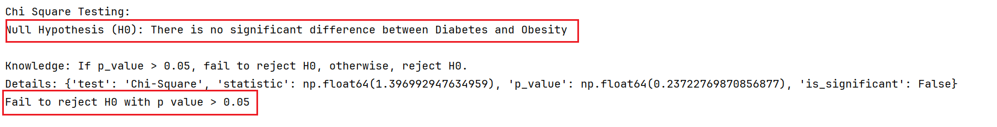
Testing Hypothesis #3
Thus, there is not enough evidence to suggest a significant association between the two variables (Diabetes and Obesity).

Slide 29
Hypothesis #4：Analyze numeric data.
Analyze：
Data: Age VS Income
Category data： Age
Category data： Income
Hypothesis：
H₀ (Null Hypothesis) : There is no significant difference between Age on Income.
H_{a} (Alternative Hypothesis) : There is a significant difference between Age on Income.

Slide 30
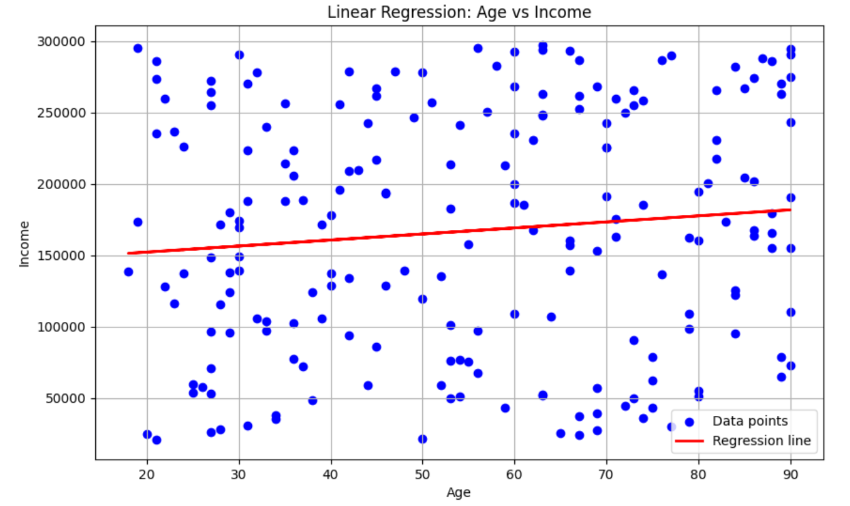
Testing Hypothesis #4
This scatter plot shows the relationship between Age (x-axis) and Income (y-axis) with a linear regression line. The data points (blue dots) are widely scattered, indicating high variability in income across all age groups.
The red regression line has a slight positive slope, suggesting a weak positive correlation between age and income. However, the large spread of data points around the line indicates that age alone is not a strong predictor of income.
There are many instances of both high and low incomes across the entire age range, from about 20 to 90 years old.

Slide 31
Testing Hypothesis #4
Linear Regression
Linear regression is a statistical method used to model the relationship between a dependent variable and one or more independent variables by fitting a linear equation to the data.
It aims to find the best-fitting line that minimizes the differences between observed and predicted values. The model is evaluated using metrics like R-squared, which indicates how well the independent variables explain the variance in the dependent variable.
Linear regression is widely used for prediction and forecasting in various fields such as economics, finance, and social sciences.

Slide 32
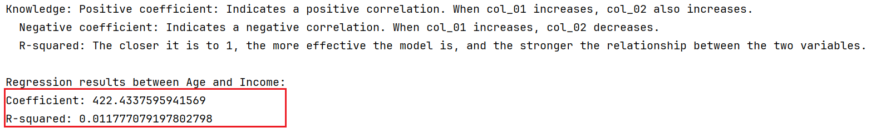
Testing Hypothesis #4
The regression results for "Age and Income" show that the coefficient is 422.4337595941569, while the R-squared value is only 0.011777079197802798, indicating that the model fits the data poorly and there is a weak relationship between the two variables.

Slide 33
Hypothesis #5：Analyze numeric and category data.
Analyze：
Data: Smoking VS Age
Category data： Smoking
Category data： Age
Hypothesis：
H₀ (Null Hypothesis) : There is no significant difference between Smoking and Age.
H_{a} (Alternative Hypothesis) : There is a significant difference between Smoking and Age.

Slide 34
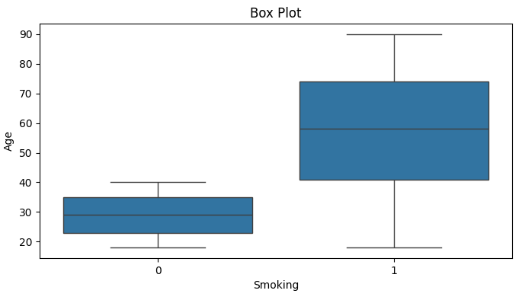
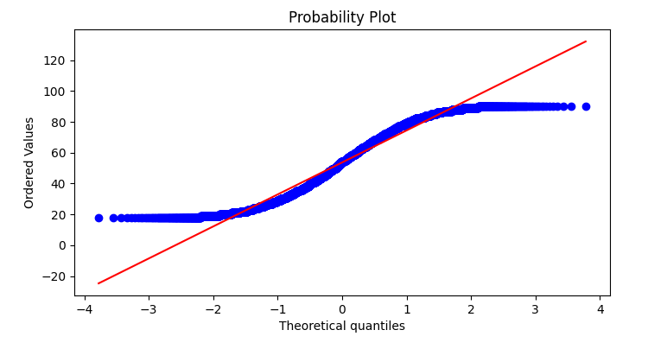
Testing Hypothesis #5
1. Box Plot:
This plot compares age distribution between non-smokers (0) and smokers (1).
Non-smokers tend to be younger, with a median age around 30. Smokers have a higher median age (about 60) and a wider age range. This suggests smoking is more prevalent among older individuals in this dataset.
2. Probability Plot (Q-Q Plot):
This plot assesses if the age data follows a normal distribution. The blue dots represent actual data points, while the red line shows the expected pattern for a normal distribution.

Slide 35
Testing Hypothesis #5
'Anderson-Darling': {
'test': 'Anderson-Darling’,
'statistic': 101.00949393153132,
'p_value': 0.0,
'is_normal': False
}
'Mann-Whitney U': {
'test': 'Mann-Whitney U’,
'statistic': 1.0,
'p_value': 1.0,
'is_significant': False
}
1. Anderson-Darling Test
The Anderson-Darling test is a non-parametric test used to determine whether a dataset follows a normal distribution. The statistic value of 91.34 indicates a significant deviation from normality.
The p-value of 0.0 provides strong evidence to reject the null hypothesis, which states that "the data follows a normal distribution." Thus, the result shows that the data does not conform to a normal distribution.
2. Mann-Whitney U Test
The Mann-Whitney U test is a non-parametric test used to assess whether there are differences between two independent samples. The statistic value of 0.0 suggests that one group has a lower rank than the other.
However, the p-value of 1.0 indicates that there is no significant difference between the two groups. Therefore, the result suggests that the difference between the groups is not statistically significant.

Slide 36
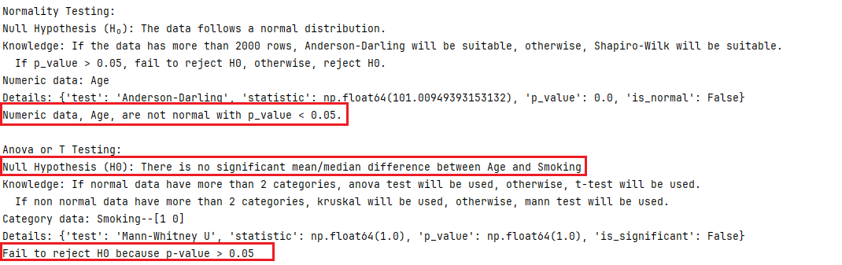
Testing Hypothesis #5
According to the Anderson-Darling test, the data does not follow a normal distribution. Meanwhile, the Mann-Whitney U test shows no significant difference between the two groups. Overall, this suggests that the data is non-normal, and there is no notable statistical difference between the compared groups.

Slide 37
(NOT MANDATORY)
Interesting results
BONUS – 5 points

Slide 38
Interesting Hypothesis
Analyze：
Data: Sex vs. Pressure Level
Category data：Sex
Category data：Pressure Level
Hypothesis：
H₀ (Null Hypothesis) : There is no significant effect between Sex and Pressure Level.
H_{a} (Alternative Hypothesis) : There is a significant effect between Sex and Pressure Level.

Slide 39
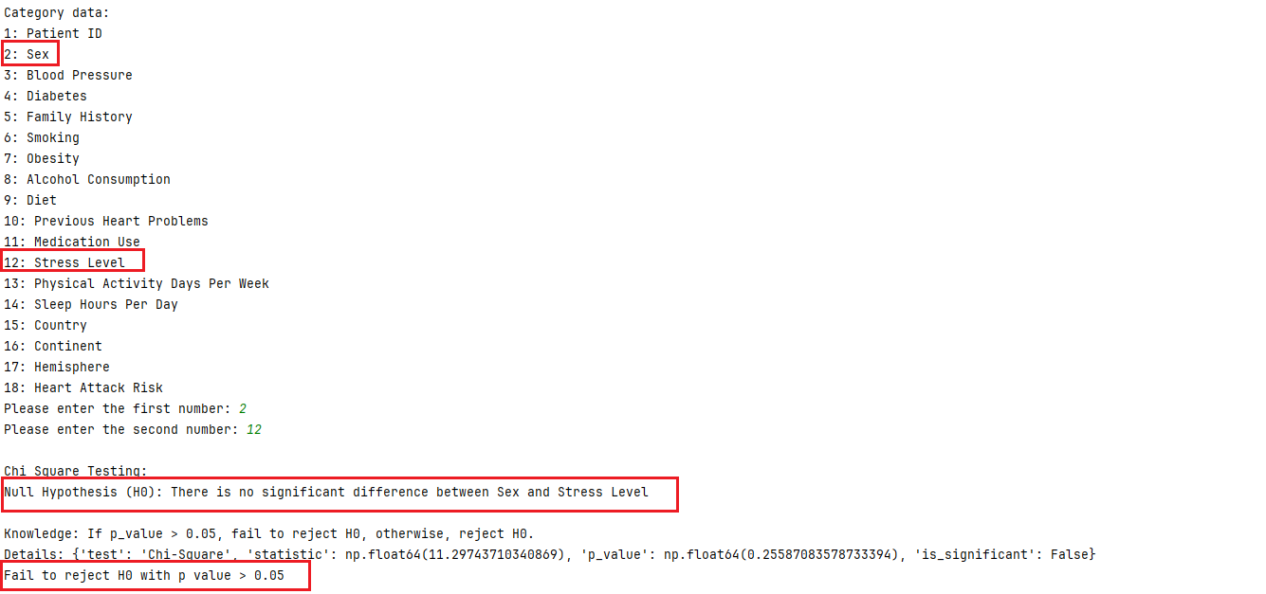
Interesting Hypothesis
Based on my Chi-Square test results:
p_value = 0.2558, which is greater than 0.05, meaning you cannot reject the null hypothesis (H0).
Null Hypothesis (H0): There is no significant difference between sex and stress levels.
Conclusion:
Failing to reject the null hypothesis means that, based on this data and the test results, there is not enough evidence to suggest a significant relationship between sex and stress levels.
In other words, the relationship between sex and stress is not significant, and we cannot conclude that sex has an impact on stress levels or that there is a meaningful association between the two.
This doesn't mean there is definitely no relationship between sex and stress, but rather, based on the current data and statistical test, we cannot confirm a relationship.

Slide 40
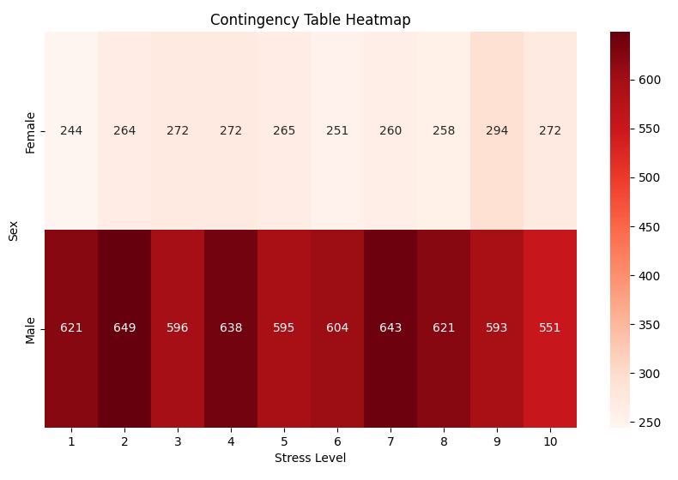
Interesting Hypothesis
This heatmap compares stress levels between males and females:
Males consistently show higher stress levels across all categories, with values ranging from 551 to 649.
Females exhibit lower stress levels, with values between 244 and 294.
Stress levels are measured on a scale from 1 to 10, likely representing increasing intensity.
Both genders show some variation across stress levels, but the overall pattern remains stable.
The stark color difference (deep red for males, light pink for females) visually emphasizes the significant gender disparity in reported stress levels.
This visualization clearly illustrates that in this dataset, males report substantially higher stress levels than females across all intensity categories.

Slide 41
End

